Slide 1
British Airways
Customer ratings analysis and insights
26-05-2023

Slide 2
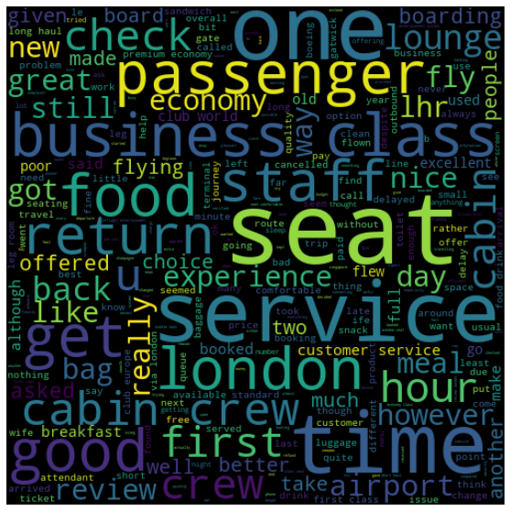
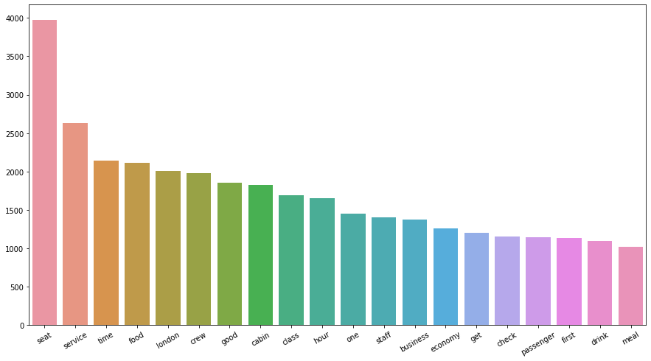
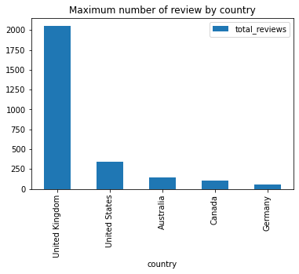
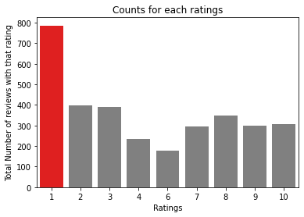
Observations and Visualisations
Average Overall Rating
4.75/10
Reviews From
68 Countries
Total Reviews Collected
3237
What are the subject customer are talking based on rating?
7-10:-cabin crew friendly , trip got good start
4-6:-Economy class middle seat , requested Asian vegetarian food.
1-3:-Middle seat blocked , Passenger front reclined seat

